Slide 1
SHAP-ENHANCED GENOMIC ANALYSIS FOR PRECISION MEDICINE
A CLINICAL CASE STUDY
Guided By:
Dr. N. Sunanda
Assistant Professor
Department of CSE- (CYS, DS) AND AI&DS
Mr. D. Veerabhadra
Assistant Professor
Department of CSE- (CYS, DS) AND AI&DS
Presented By:
B. Sathwika (22071A6769)
K. Charana (22071A6788)
P. Vaishnavi (22071A67A4)
P. Mahima Gayatri (22071A67A7)

Slide 2

INTRODUCTION
Breast cancer is the most commonly diagnosed cancer among women worldwide and remains a major global health concern. According to recent statistics, more than 2.3 million new cases are reported annually, resulting in a significant number of deaths each year. The disease is highly complex due to its heterogeneous nature, involving diverse genetic mutations, molecular subtypes, and varying clinical outcomes. Therefore, accurate survival prediction is essential for effective treatment planning, risk assessment, and personalized healthcare. Traditional survival analysis methods such as the Cox Proportional Hazards model and Kaplan–Meier estimators have been widely used in clinical research.

Slide 3
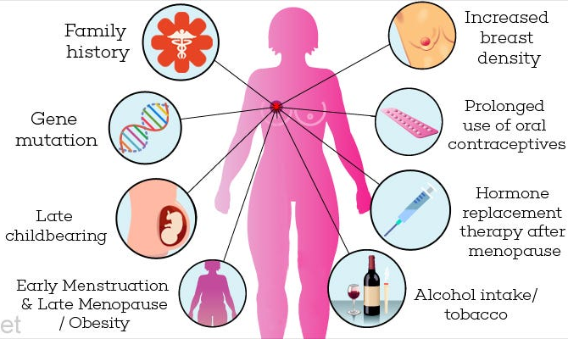
INTRODUCTION
However, these methods rely on strong statistical assumptions and often struggle to capture complex nonlinear relationships present in large-scale clinical and genomic datasets. With the availability of large biomedical datasets such as METABRIC, machine learning approaches have emerged as powerful tools for improving prediction accuracy. In particular, Random Forest models can effectively handle complex data patterns, while explainable AI methods like SHAP help provide transparent and interpretable predictions for clinical decision support.

Slide 4
RESEARCH GAPS
After reviewing previous studies, several important gaps were found. Most works used small or less varied datasets, which limits how well models work for different patients. Many models were not tested in real hospital environments, making their real-world reliability unclear. There is also limited large-scale testing using real genomic (gene) data.
Only a few studies examined how stable SHAP explanations are when data is changed. Many focused more on clinical data than deep gene-level analysis. Most systems work on only one cancer type, mainly breast cancer, and lack support for multiple cancer types.
Current systems rarely combine disease prediction, survival estimation, and explainable AI in one complete framework, and few provide easy-to-understand reports for both doctors and patients.
These gaps highlight the need for a reliable, scalable system that uses real-world data and provides accurate, trustworthy explanations.

Slide 5





MATERIALS AND METHODS
Materials:
Breast cancer genomic dataset (public sources)
Python, Jupyter/Colab, libraries: NumPy, Pandas,
Streamlit, Scikit-learn, SHAP, Matplotlib
Laptop/Desktop with 8GB+ RAM
Methods / Steps:
Data Collection & Preprocessing – Clean, normalize, split dataset
Feature Selection – Identify important genes
Model Building – Random Forest for cancer prediction
Explainability – SHAP to show gene influence
Survival Estimation – Predict patient survival probability
Dual Report Generation – Doctor (detailed) & Patient (simple) reports
Evaluation – Accuracy, precision, recall, F1-score

Slide 6
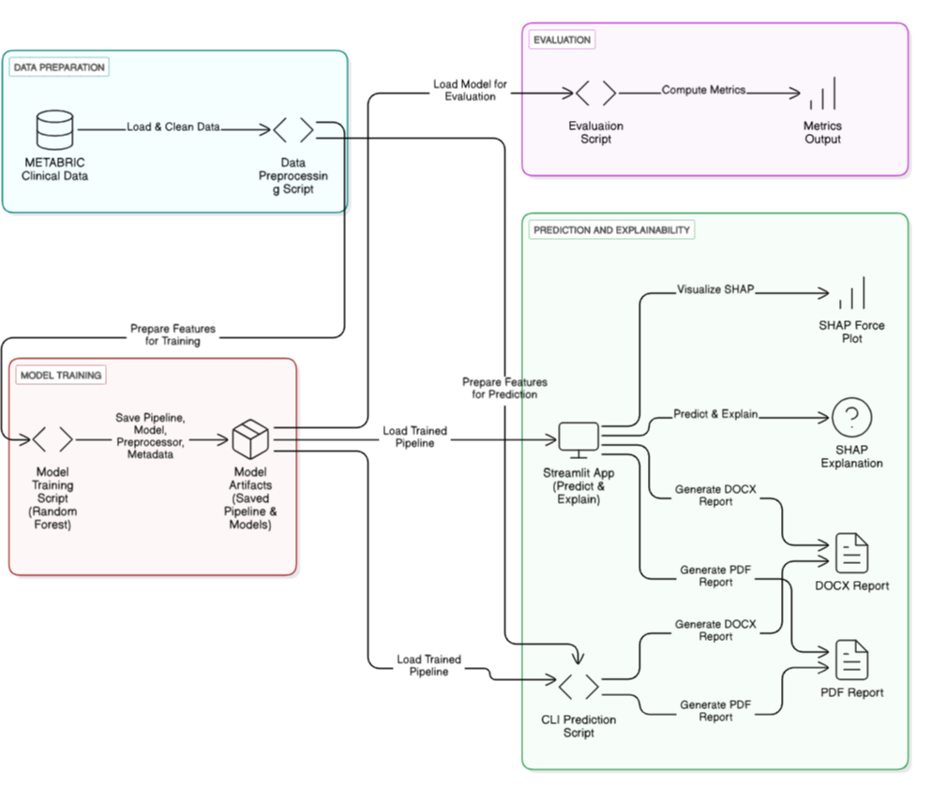
SIGNIFICANCE OF THE PROPOSED SYSTEM
The proposed system provides:
Interpretable AI Framework
Uses SHAP for transparent predictions.
Dual Prediction Capability
Predicts survival status (classification)
Predicts survival time in months (regression)
Data-Driven Clinical Insights
Identifies key survival risk factors.
Practical Deployment
Interactive web application using Streamlit.
This supports precision oncology and clinical decision-making.

Slide 7
RESULTS AND DISCUSSION
1. Model Performance
The machine learning model (Random Forest) was trained on the breast cancer genomic dataset.
Accuracy: 96% on test data
The model successfully predicted the survival rate based on gene expression values.
2. Explainability (SHAP Analysis)
SHAP analysis identified the most important genes affecting predictions.
Each patient’s prediction was explained in terms of gene influence, helping doctors understand the biological factors behind the risk.
Example: Certain genes had a high positive contribution to predicting cancer, while others reduced risk.

Slide 8
3. Survival Rate Estimation
The survival prediction module provided an estimated survival probability based on patient genomic and clinical features.
Helps doctors evaluate treatment options and prioritize high-risk patients.
4. Dual Report Generation
Doctor Report: Detailed information including model prediction, SHAP gene contribution, and risk analysis.
Patient Report: Simplified summary explaining risk, lifestyle factors, and precautions in easy-to-understand language.
This approach improves communication between doctors and patients, making the predictions actionable.

Slide 9
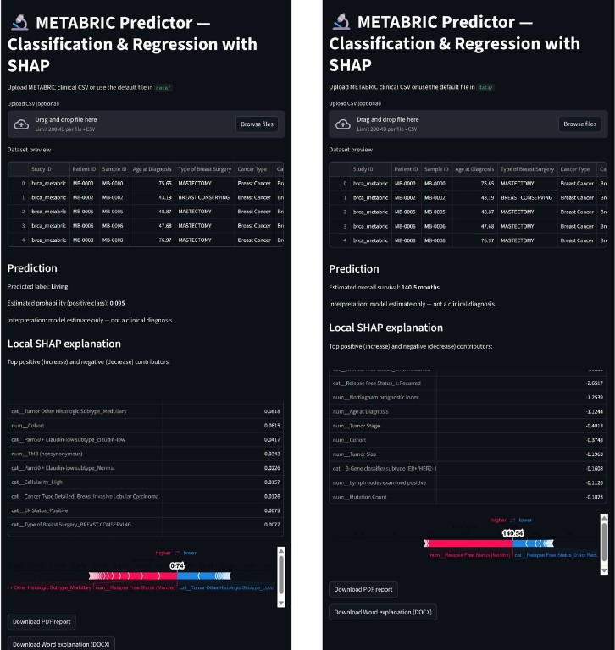
Metric | Value
Sample Size | 2,509
Accuracy | 0.963
ROC-AUC | 0.991
Sensitivity | 0.95
Specificity | 0.97
Precision | 0.96
F1-score | 0.96
Cross-validation Accuracy | 0.937
Cross-validation ROC-AUC | 0.978
Metric | Value
Sample Size | 1,981
MAE (months) | 6.65
RMSE (months) | 15.01
R² (in-sample) | 0.961
MDAE (months) | 0.84
Within ±6 months | 71.2%
Within ±12 months | 83.3%
Cross-validated MAE | 12.92
Cross-validated RMSE | 27.60
Cross-validated R² | 0.868
Streamlit UI: displays predictions, SHAP force plot, and customizable export for clinician workflow
Classification Metrics on METABRIC (Random Forest)
Regression Metrics on METABRIC (Random Forest)

Slide 10
Conclusion
This study presents an interpretable machine learning framework for predicting breast cancer survival using the METABRIC dataset. A combination of Random Forest models and SHAP enables both high predictive accuracy and model transparency. The classification model achieved strong performance (ROC-AUC = 0.991), while the regression model demonstrated high survival time prediction accuracy (R² = 0.961). SHAP analysis identified key predictors such as age, tumor grade, and relapse status. Although external validation is required, the framework highlights the potential of explainable ensemble learning for clinical decision support in precision oncology.

Slide 11
REFERENCES
Dhillon, P. K. (2009). Breast cancer factsheet. Mortality, 11(12.5), 10-8.
Giaquinto, A. N., Sung, H., Newman, L. A., Freedman, R. A., Smith, R. A., Star, J., ... & Siegel, R. L. (2024). Breast cancer statistics 2024. CA: a cancer journal for clinicians, 74(6), 477-495.
Jemal, A., Bray, F., Center, M. M., Ferlay, J., Ward, E., & Forman, D. (2011). Global cancer statistics. CA: a cancer journal for clinicians, 61(2), 69-90.
Curtis, C., Shah, S. P., Chin, S. F., Turashvili, G., Rueda, O. M., Dunning, M. J., ... & British Columbia Cancer Agency Aparicio Samuel saparicio@ bccrc. ca 17 18 b Shah Sohrab P. 17 18 Bashashati Ali 17 Ha Gavin 17 Haffari Gholamreza 17 McKinney Steven 17 18. (2012). The genomic and transcriptomic architecture of 2,000 breast tumours reveals novel subgroups. Nature, 486(7403), 346-352.
Ghasemi, A., Hashtarkhani, S., Schwartz, D. L., & Shaban‐Nejad, A. (2024). Explainable artificial intelligence in breast cancer detection and risk prediction: A systematic scoping review. Cancer Innovation, 3(5), e136.

Slide 12
THANK YOU

